Slide 1
Day 3: Introduction to Geospatial Data on Environment and Agriculture

Slide 2
Recap of what’s covered on Day 2
Reprojection (revisited)
Zonal statistics
Data quality issues
Data cleaning
Geometric operations with vector data
Geometric operations with raster data

Slide 3
Today’s Agenda
Overview of geospatial data on environment and agriculture
Working with spatio-temporal data
Data quality issues with geospatial data on environment and agriculture
Hands-on exercise:
Integration of agriculture and environment data into analysis
Data visualization

Slide 4
Overview of geospatial data in environment and agriculture

Slide 5



Overview of geospatial data in environment and agriculture
Risk = Hazard × Exposure × Vulnerability
Risk component | Description
Hazard | The hazard occurrence probability and intensity (i.e., physical magnitude) in a particular location
Exposure | The people and physical assets (infrastructures, buildings, crops, etc.) situated in that location and therefore exposed to the hazard
Vulnerability | The conditions determined by physical, social, and economic factors which increase the susceptibility of an exposed individual, community, asset or system to the impacts of hazards
Sources: Adopted from Amadio M. (GFDRR) - CCDR tools data and methodology, 2023. Available at https://gfdrr.github.io/CCDR-tools

Slide 6
Overview of geospatial data in environment and agriculture
Risk component | Examples of data sources
Hazard | See GFDRR website Drought - the Agricultural Stress Index (ASI), the Vegetation Health Index (VHI), Standardised Precipitation-Evapotranspiration Index (SPEI) Flood – Fathom, HDX, Resilience Academy; Global Flood Database, Precipitation / temperature – Climate Research Unit ; CHIRPS Heat waves - GFDRR Greenhouse gases - EDGAR - Emissions Database for Global Atmospheric Research Air pollutions - Copernicus Atmosphere Monitoring Service (CAMS)
Exposure | Population – WorldPop/GRID3, GHS-POP, LandScan, Meta Road – OpenStreetMap Building footprints – Google, Microsoft, Ecopia, WorldPop/GRID3, GHSL, OpenStreetMap Landcover/Cropland – FAO, ESRI landcover, Potapov et al. (2022) Deforestation - Global Forest Change 2000-2022 Data Agricultural production – MapSPAM, GAEZ v4
Vulnerability | Poverty map (produced in 2018) Nighttime light – VIIRS Relative Wealth Index – Meta Access to markets, schools and health facilities – Weiss et al. (2018) and (2020), OpenStreetMap, WHO health facility database

Slide 7
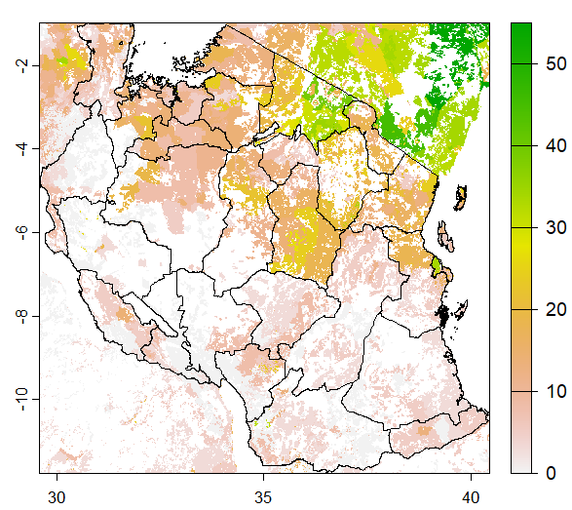
Hazard (example 1): Agricultural Stress Index (from FAO)
ASI uses satellite-based remote sensing data to detect agricultural areas (cropland or grassland) with a high likelihood of water stress (dry spells and drought).
This map presents a Historic Agricultural Drought Frequency Map depicting the frequency of severe drought in areas where 30 percent percent of the cropland/grassland has been affected.
Formula: The number of years when land affected>30 percent percent occurred/(2022-1984+1) *100
The historical frequency of severe droughts (as defined by ASI) is based on the entire ASI times series (1984-2022).
Source: raster data can be downloaded from GEE
Notes:
See more: https://documents1.worldbank.org/curated/en/099602511292336760/pdf/IDU07639ca570f3cb048db09bf60fc2cc82df22d.pdf

Slide 8
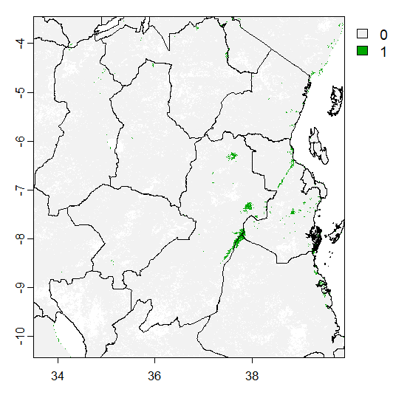
Flood (example 2): NOAA VIIRS Flood Map from HDX
NOAA VIIRS Flood (5 days composite) as recorded in November 17, 2023
Applying machine learning algorithms such as the decision-tree approach and open water likelihood method to detect flooding and standing water from satellite (e.g., Suomi-NPP and NOAA-20 VIIRS) imagery
Source: HDX
Notes:
See more details https://www.star.nesdis.noaa.gov/jpss/documents/ATBD/ATBD_VIIRS_Flood_Mapping_v1.0.pdf

Slide 9
How to read climate / natural disaster risk data
3-lecture_code.R

Slide 10
Working with spatio-temporal dataset

Slide 11
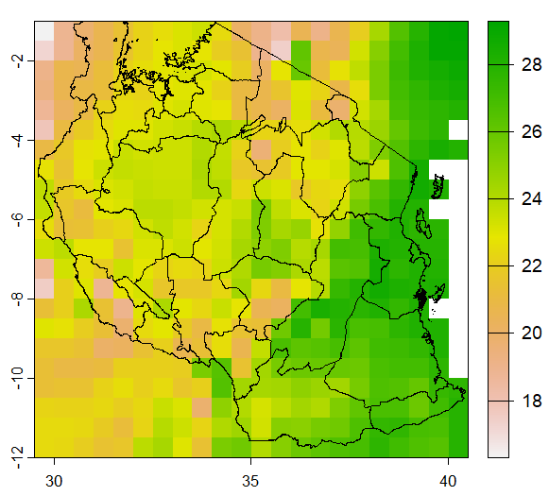
Temperature (example 3): CRU
Avg. monthly temperature from the Climate Research Unit
Available from January 1901 through December 2022 at a spatial resolution of 0.5° (about 50km)
Use extensive networks of weather station observations and apply interpolation
Source: raster data can be downloaded from GEE
Notes:
See more details: https://www.nature.com/articles/s41597-020-0453-3

Slide 12
Working with spatio-temporal data
3-lecture_code.R

Slide 13
Data quality issues with geospatial data on environment and agriculture

Slide 14
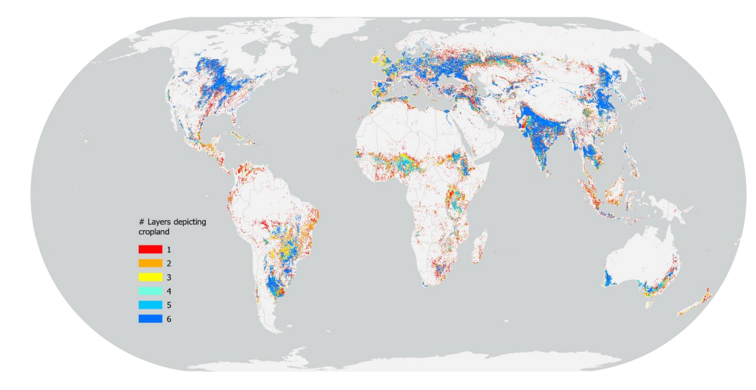
Data quality
Big data are not a panacea!
Always cross-check with the numbers you get from different sources
Consult with country/sector experts to ensure quality
Significant disagreements across different data sources on cropland
Potapov et al. (2022) estimate of a 9% cropland expansion from 2003 to 2019, with trends accelerating over the study period.
The FAO data indicated instead a much smaller growth (2%-6%)
Map of agreement/disagreement produced by consolidating information at pixel level from six high resolution maps of cropland
Source: Tubiello et al. (2023)
Notes:
See https://www.researchgate.net/profile/Francesco-Tubiello/publication/361812372_Measuring_the_world's_cropland_area/links/62c6aa4c34a4a972fd194720/Measuring-the-worlds-cropland-area.pdf

Slide 15
Data quality
Another good illustration of how data sources matter where different building footprint datasets yield significantly different results in terms of the spatial distribution of building counts in sub-Saharan Africa (Chamberlain et al. 2023)
Source: Chamberlain et al. 2023

Slide 16
Indicator selection
The universal definition of drought impractical (Lloyd-hughes 2014)
All the drought indicators seem to more or less agree on the time of drought onset and recovery although there is disagreement on the extent of the affected area (Naumann et al. 2014).
Which drought indicator to be used for targeting depends on the objectives of a project…
Source: Naumann et al. 2014
Notes:
https://hess.copernicus.org/articles/18/1625/2014/hess-18-1625-2014.pdf

Slide 17
Let’s do a hands-on exercise to recap what’s covered today!

Slide 18
Climate and Agriculture Statistics using geospatial data
Tasks
Task 1: Overlay various layers of spatial data and save as a map
Plot cropland, forest cover, etc. with the locations of roads, cities, etc.
Task 2: Work with climate data – precipitation, temperature
Plot a map of average monthly temperature and precipitation for Tanzania by region (December 2022)
Plot trends in monthly temperature and precipitation for Tanzania by region (1901-2022)
Plot the standard deviation of avg. monthly temperature and precipitation for Tanzania by region (against the long term mean 1901-2022)
Task 3: Work with natural disaster risk indicators
% of people/cropland in drought area

Slide 19
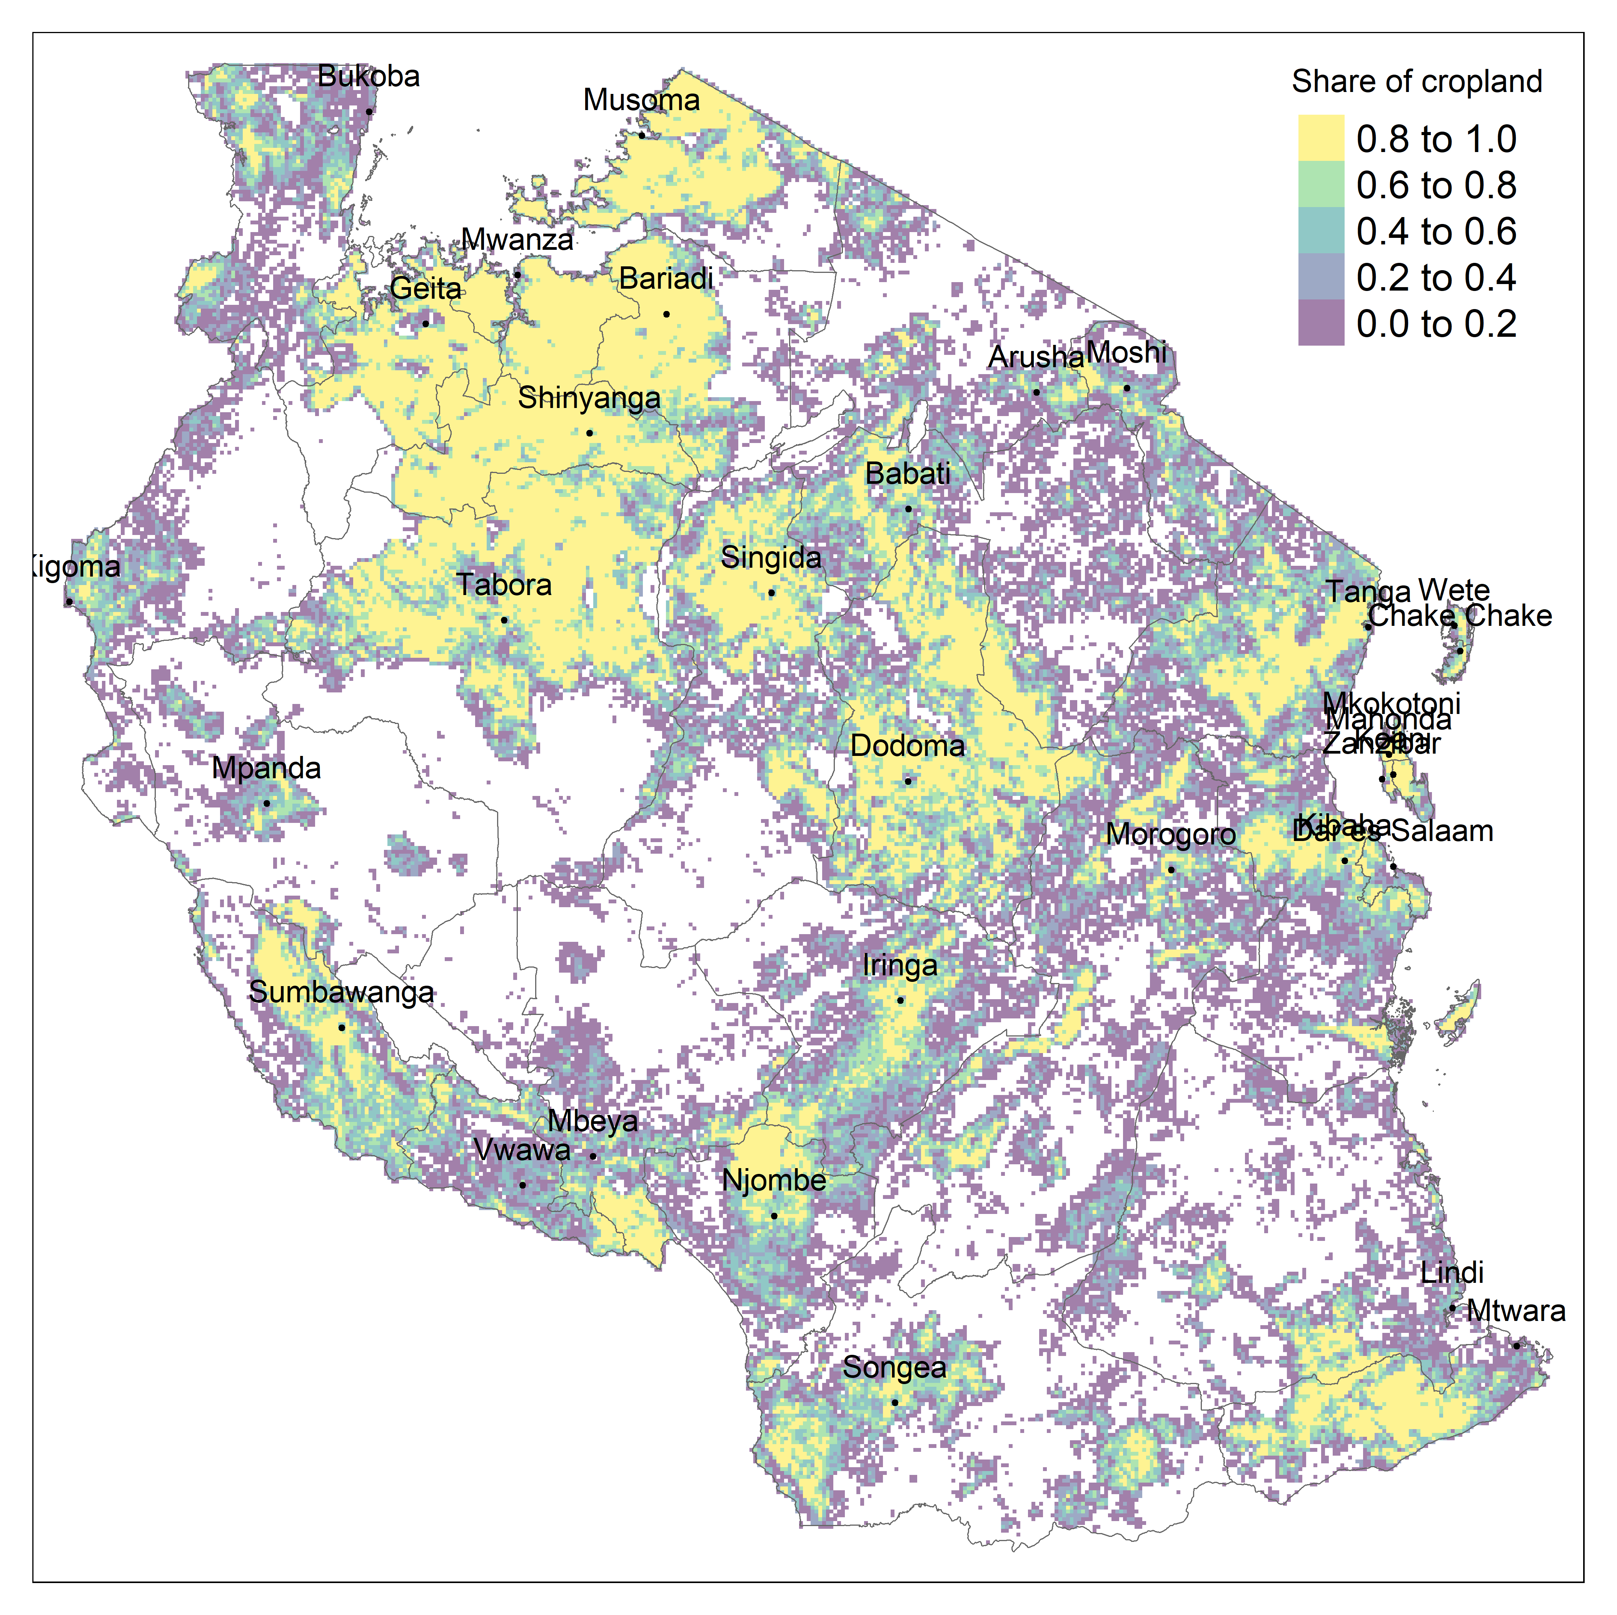
Task 1: Overlay various layers of spatial data and save as a map
Datasets:
ADM1 boundary shapefile from HDX
Landcover data on cropland from FAO
Locations of cities from World Cities Database
Replication code: 3.1-handson.R

Slide 20
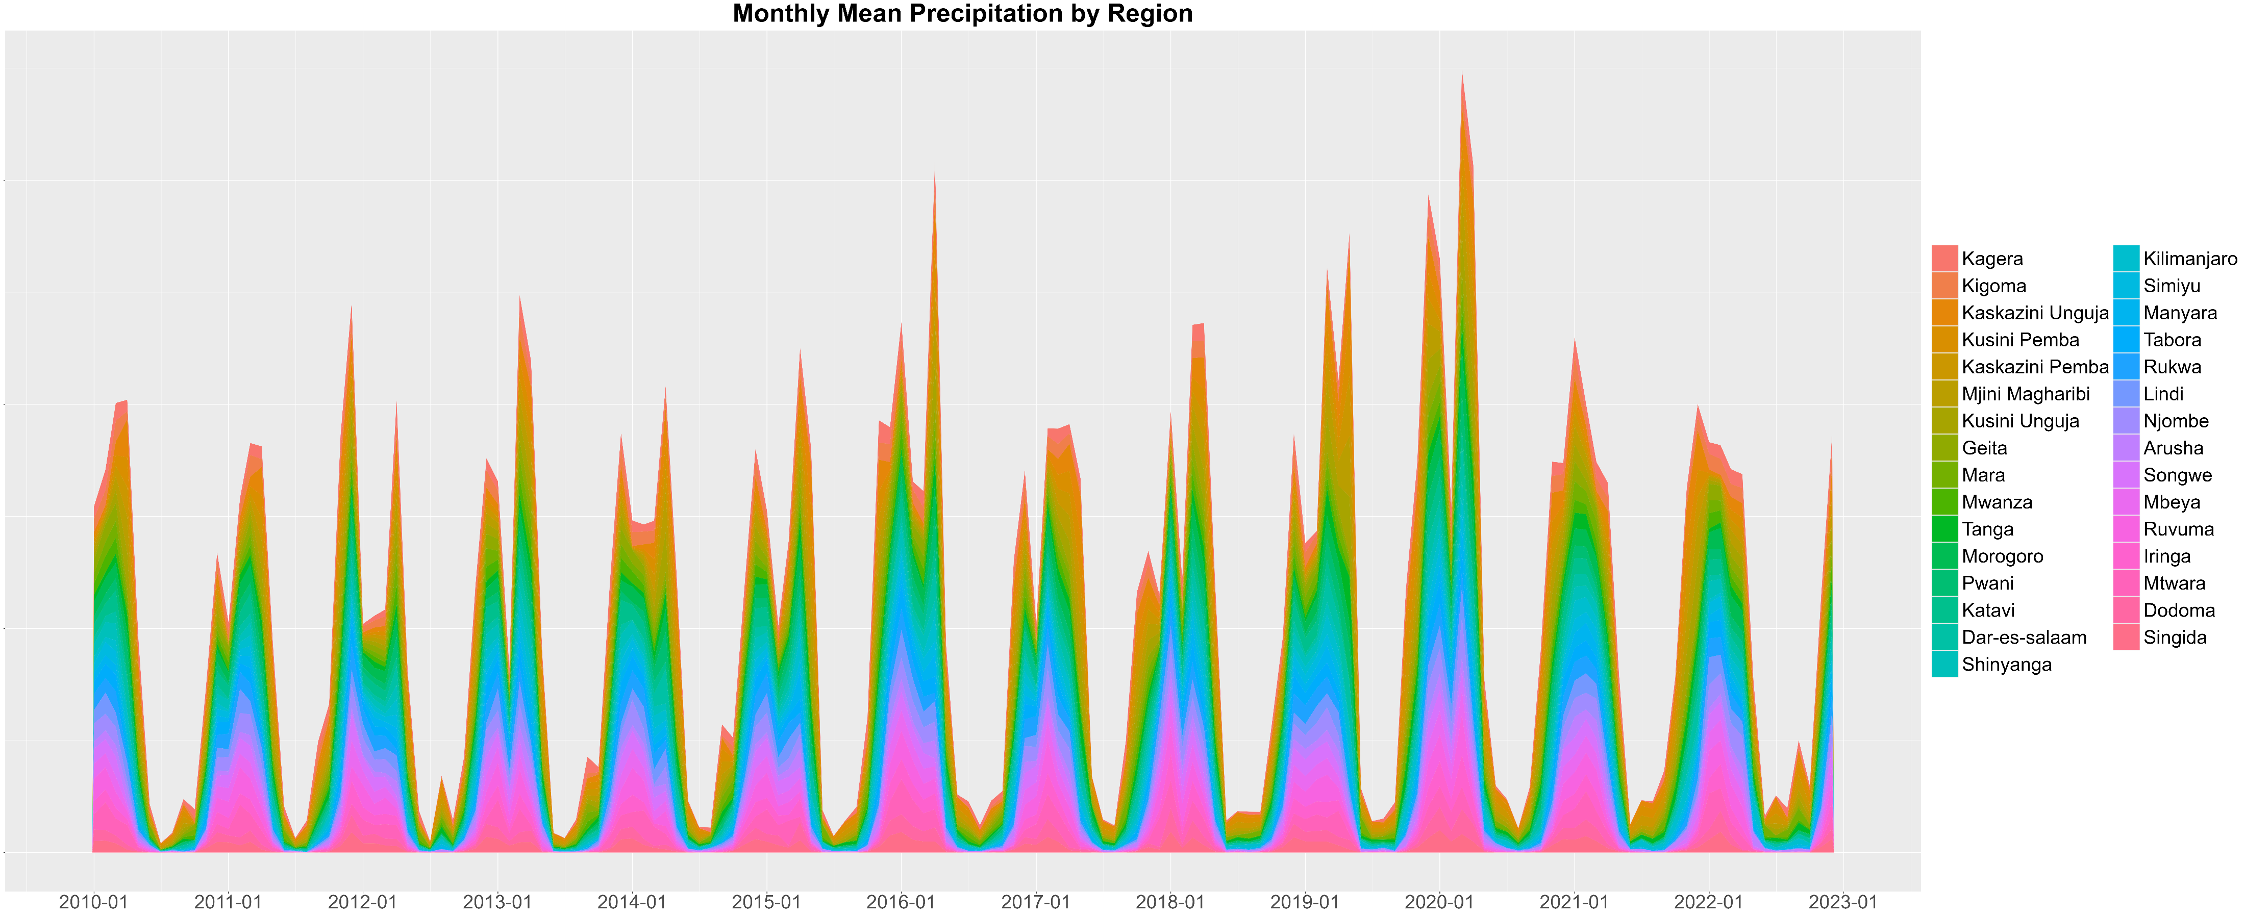
Task 2: Work with climate data – precipitation, temperature
Datasets:
ADM1 boundary shapefile from HDX
Precipitation/temperature data from the Climate Research Unit
Replication code: 3.2-handson.R

Slide 21
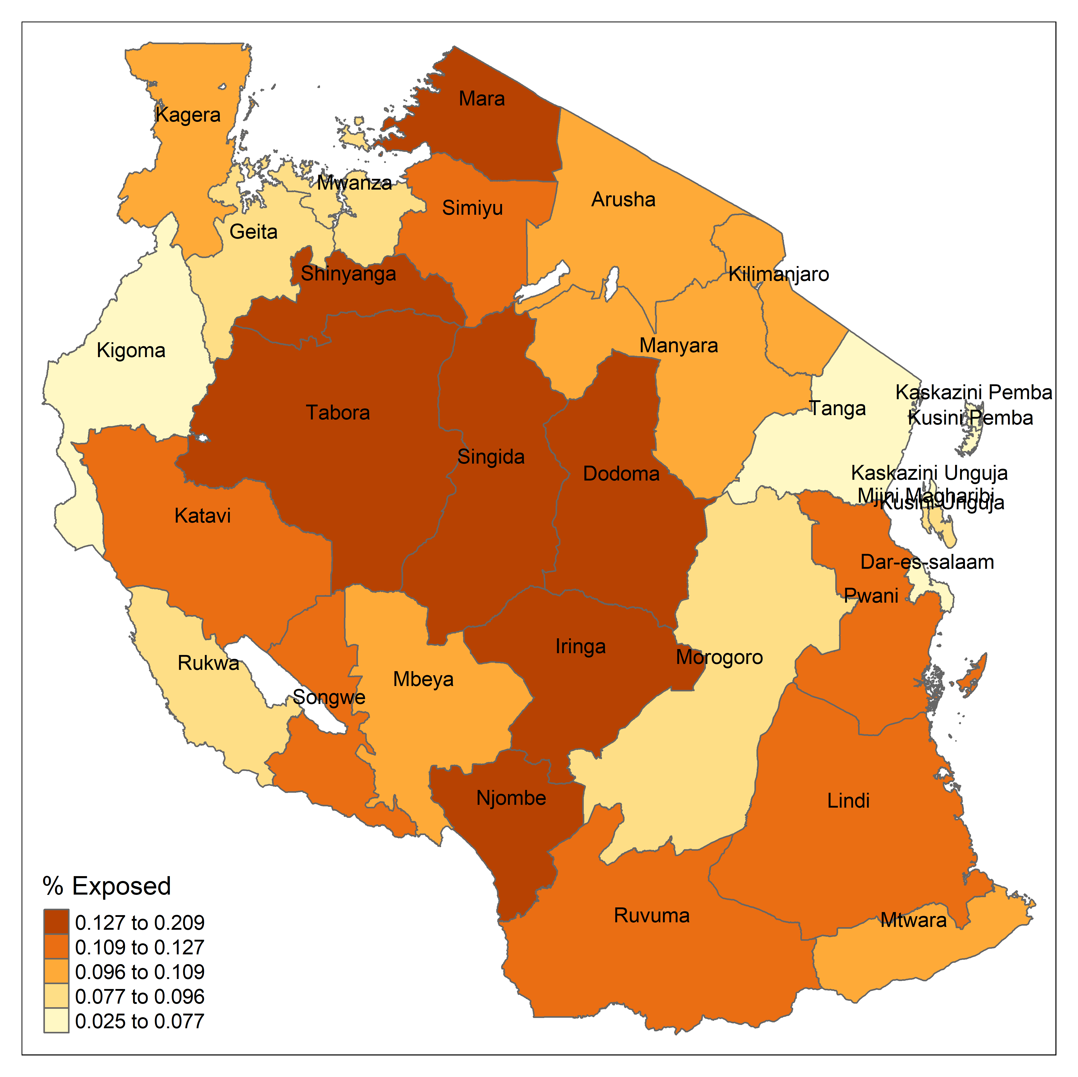
Task 3: Work with natural disaster risk indicators
Datasets:
ADM1 boundary shapefile from HDX
Drought index from FAO
Population data from WorldPop
Urban extent from GRUMP
Replication code: 3.3-handson.R

